Slide 1



Virat Kohli
View in Power BI
Last data refresh:
01-10-2023 13:51:25 UTC
Downloaded at:
01-10-2023 13:53:33 UTC

Slide 2
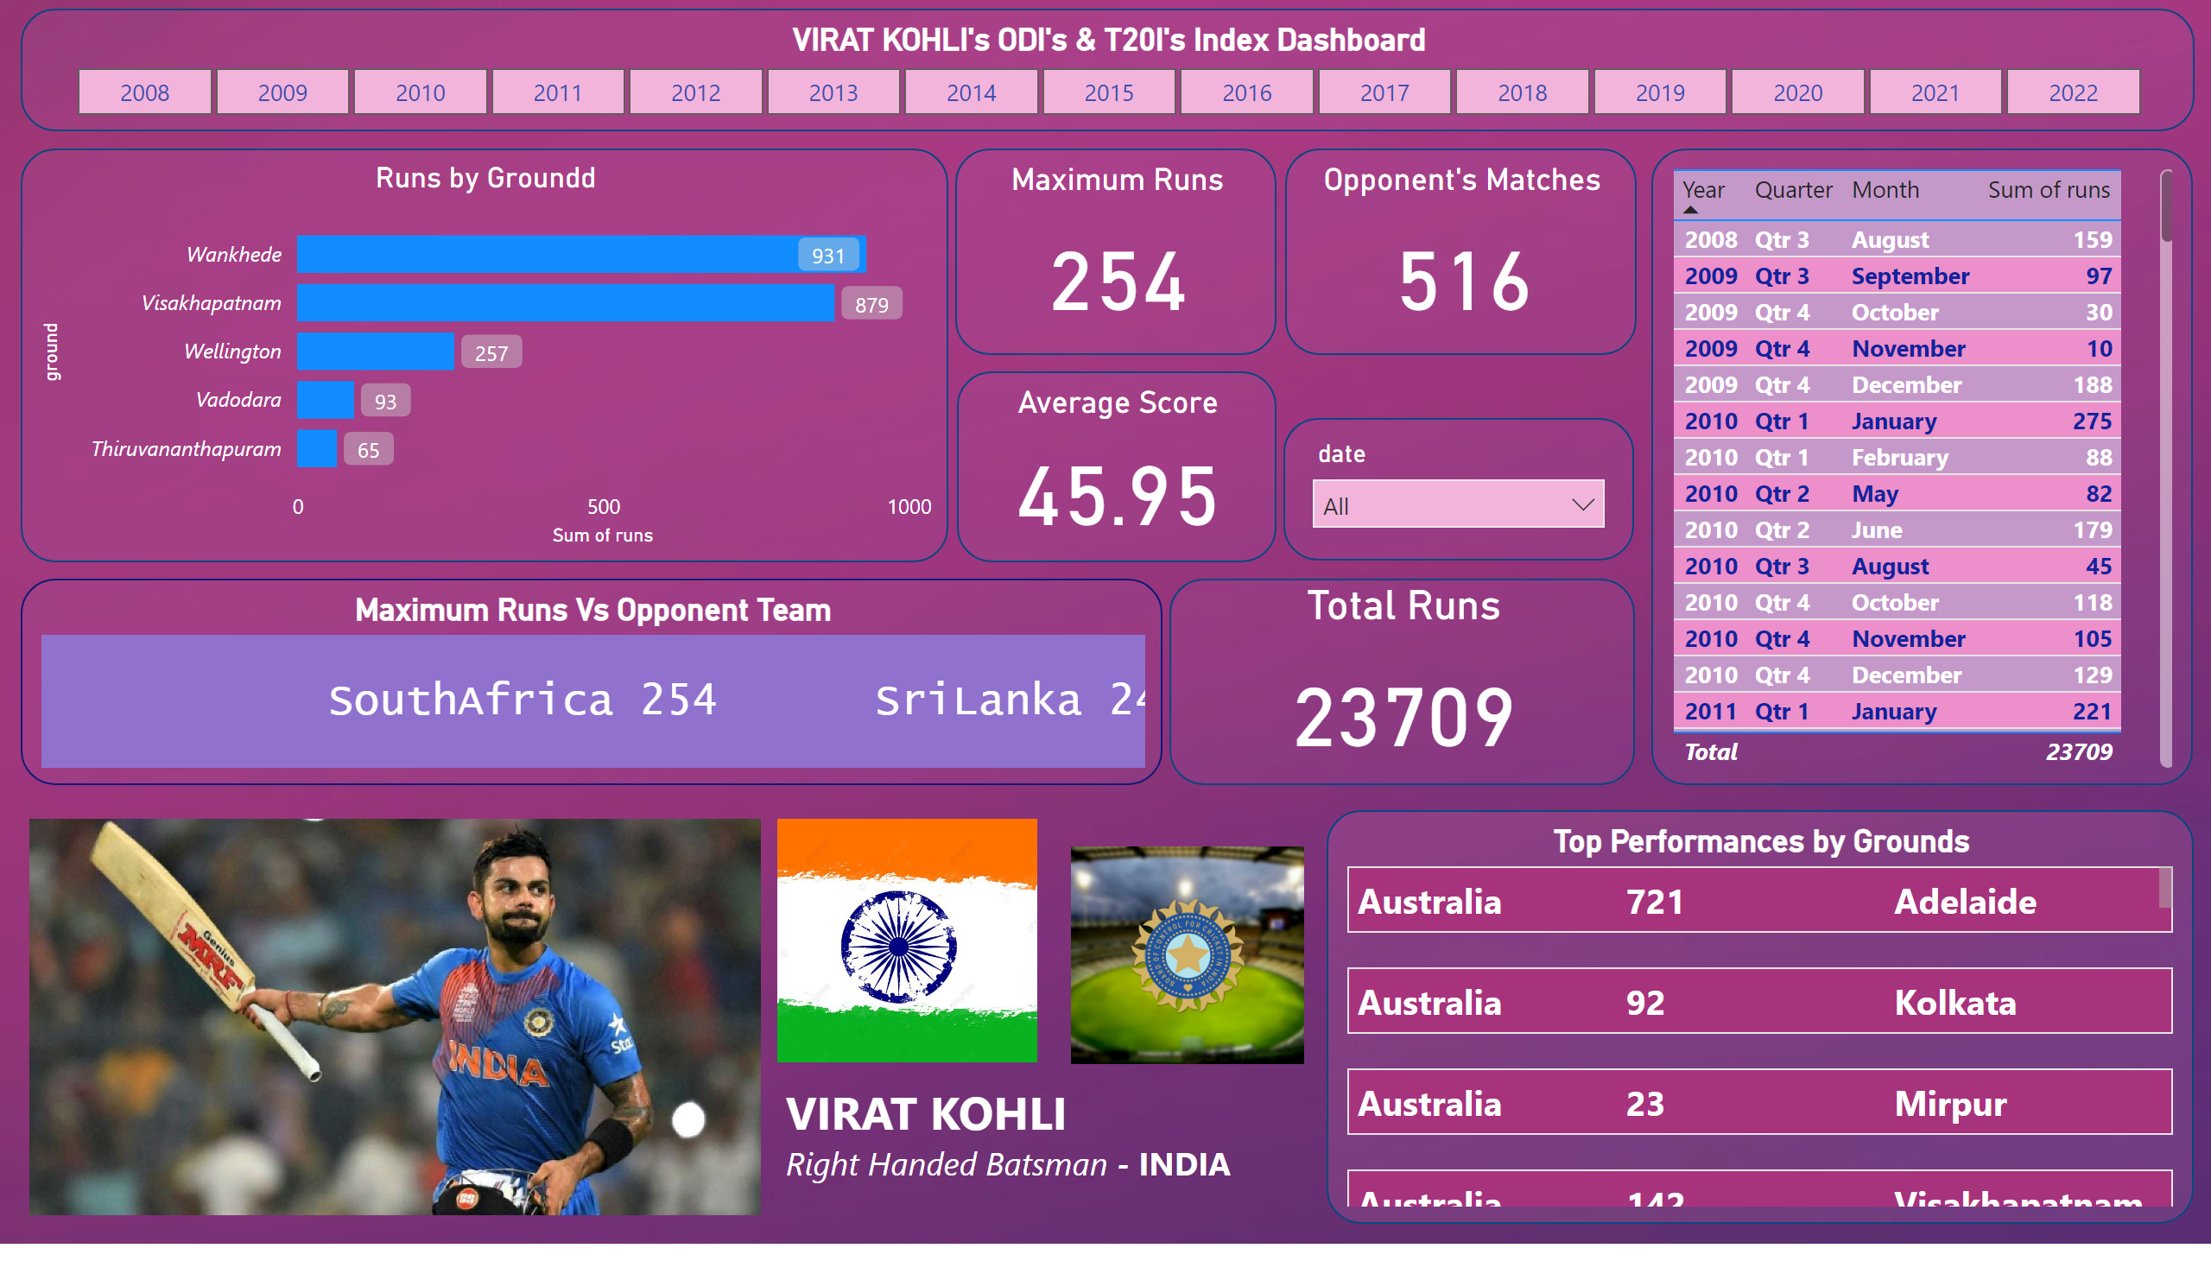
Page 1
Notes:
VIRAT KOHLI's ODI's & T20I's Index Dashboard
No alt text provided
Runs by Groundd
No alt text provided
tableEx
No alt text provided
Maximum Runs Vs Opponent Team
No alt text provided
Opponent's Matches
No alt text provided
Total Runs
No alt text provided
Average Score
No alt text provided
Maximum Runs
No alt text provided
slicer
No alt text provided
Top Performances by Grounds
No alt text provided
image
No alt text provided
image
No alt text provided
textbox
No alt text provided
image
No alt text provided

